Slide 1
Managing Space

Slide 2
Objectives
After completing this lesson, you should be able to:
  Describe how the Oracle database server automatically manages space
  Save space by using compression
  Proactively monitor and manage tablespace space usage
  Describe segment creation in the Oracle database
  Control deferred segment creation
  Use the Segment Advisor
  Reclaim wasted space from tables and indexes by using the segment shrink functionality
  Manage resumable space allocation
Notes:
Oracle Database 11g: Administration Workshop II 18 - <number>

Slide 3
Space Management: Overview
Space is automatically managed by the Oracle database server. It generates alerts about potential problems and recommends possible solutions. Features include:
  Oracle Managed Files (OMF)
  Free-space management with bitmaps (“locally managed”) and automatic data file extension
  Proactive space management (default thresholds and server-generated alerts)
  Space reclamation (shrinking segments, online table redefinition)
  Capacity planning (growth reports)
Notes:
Space Management: Overview
With Oracle Managed Files (OMF), you can specify operations in terms of database objects rather than file names. The Oracle database server can manage free space within a tablespace with bitmaps. This is known as a “locally managed” tablespace. In addition, free space within segments located in locally managed tablespaces can be managed using bitmaps. This is known as Automatic Segment Space Management. The bitmapped implementation eliminates much space-related tuning of tables, while providing improved performance during peak loads. Additionally, the Oracle database server provides automatic extension of data files, so the files can grow automatically based on the amount of data in the files.
When you create a database, proactive space monitoring is enabled by default. (This causes no performance impact.) The Oracle database server monitors space utilization during normal space allocation and deallocation operations and alerts you if the free space availability falls below the predefined thresholds (which you can override). Advisors and wizards assist you with space reclamation.
For capacity planning, the Oracle database server provides space estimates based on table structure and number of rows and a growth trend report based on historical space utilization stored in the Automatic Workload Repository (AWR).
(The topics are covered in this and the following lesson.)

Slide 4
Block Space Management
PCTFREE = 10
FS2
FS3
FS1
FS1
FS2
Inserts,
updates
Deletes
Deletes
FS3
FS4
Full block
Full block
Notes:
Oracle Database 11g: Administration Workshop II 18 - <number>
Block Space Management
Space management involves the management of free space at the block level. With Automatic Segment Space Management, each block is divided into four sections, named FS1 (between 0 and 25% of free space), FS2 (25% to50% free), FS3 (50% to 75% free), and FS4 (75% to 100% free).
Depending on the level of free space in the block, its status is automatically updated. That way, depending on the length of an inserted row, you can tell whether a particular block can be used to satisfy an insert operation. Note that a “full” status means that a block is no longer available for inserts.
In the slide example, the block on the left is an FS3 block because it has between 50% and 75% free space. After some insert and update statements, PCTFREE is reached (the dashed line) and it is no longer possible to insert new rows in that block. The block is now considered as a “full” or FS1 block. The block is considered for insertion again, as soon as its free space level drops below the next section. In the preceding case, it gets status FS2 as soon as the free space is more than 25%.
Note: Large object (LOB) data types (BLOB, CLOB, NCLOB, and BFILE) do not use the PCTFREE storage parameter. Uncompressed and OLTP-compressed blocks have a default PCTFREE value of 10; basic compressed blocks have a default PCTFREE value of 0.

Slide 5
Row Chaining and Migration
Example:
  On update: Row length increases,
  exceeding the available free space
  in the block.
  Data needs to be stored in a new block.
  Original physical identifier of row
  (ROWID) is preserved.
  The Oracle database server needs
  to read two blocks to retrieve data.
  The Segment Advisor finds segments
  containing the migrated rows.
  There is automatic coalescing of fragmented
  free space inside the block.
Old
Original block with pointer to migrated row
New data
Notes:
Row Chaining and Migrating
In two circumstances, the data for a row in a table may be too large to fit into a single data block. In the first case, the row is too large to fit into one data block when it is first inserted. In this case, the Oracle database server stores the data for the row in a chain of data blocks (one or more) reserved for that segment. Row chaining most often occurs with large rows, such as rows that contain a column of data type LONG or LONG RAW. Row chaining in these cases is unavoidable.
However, in the second case, a row that originally fit into one data block is updated, so that the overall row length increases, and the block’s free space is already completely filled. In this case, the Oracle database server migrates the data for the entire row to a new data block, assuming that the entire row can fit in a new block. The database preserves the original row piece of a migrated row to point to the new block containing the migrated row. The ROWID of a migrated row does not change.
When a row is chained or migrated, input/output (I/O) performance associated with this row decreases because the Oracle database server must scan more than one data block to retrieve the information for the row.
The Segment Advisor finds the segments containing migrated rows that result from an UPDATE.

Slide 6
Notes Page: Row Chaining and Migrating
Notes:
Row Chaining and Migrating (continued)
The Oracle database automatically and transparently coalesces the free space of a data block when:
An INSERT or UPDATE statement attempts to use a block with sufficient free space for a new row piece
The free space is fragmented, so that the row piece cannot be inserted in a contiguous section of the block
After coalescing, the amount of free space is identical to the amount before the operation, but the space is now contiguous.

Slide 7
Quiz
When a row is chained or migrated, the I/O performance associated with this row decreases because the Oracle database server must scan more than one data block to retrieve the information for the row.
  True
  False
Notes:
Answer: 1

Slide 8
Free Space Management Within Segments
BMB
BMB
BMB
…
BMB
  Tracked by bitmaps in segments
  Benefits:
  More flexible space utilization
  Run-time adjustment
  Multiple process search of BMBs
BMB
BMB
…
BMB
…
…
…
…
…
…
…
…
Data
block
…
{
Extent
Segment
Notes:
Free Space Management
Free space can be managed automatically inside database segments. The in-segment free or used space is tracked with bitmaps. To take advantage of this feature, specify Automatic Segment Space Management, when you create a locally managed tablespace. Your specification then applies to all segments subsequently created in this tablespace.
Automatic space management segments have a set of bitmap blocks (BMBs) describing the space utilization of the data blocks in that segment. BMBs are organized in a tree hierarchy. The root level of the hierarchy, which contains the references to all intermediate BMBs, is stored in the segment header. The leaves of this hierarchy represent the space information for a set of contiguous data blocks that belong to the segment. The maximum number of levels inside this hierarchy is three.
Benefits of using automatic space management include:
Better space utilization, especially for the objects with highly varying row sizes
Better run-time adjustment to variations in concurrent access
Better multi-instance behavior in terms of performance or space utilization
Therefore, less work for you, the DBA.

Slide 9
Types of Segments
A segment is a set of extents allocated for a certain logical structure. The different types of segments include:
  Table and cluster segments
  Index segment
  Undo segment
  Temporary segment
Segments are dynamically allocated by the Oracle database server.
Notes:
Types of Segments
Table and cluster segments: Each nonclustered table has a data segment. All table data is stored in the extents of the table segment. For a partitioned table, each partition has a data segment. Each cluster has a data segment. The data of every table in the cluster is stored in the cluster’s data segment.
Index segment: Each index has an index segment that stores all of its data. For a partitioned index, each partition has an index segment.
Undo segment: Oracle Database maintains information to reverse changes made to the database. This information consists of records of the actions of transactions, collectively known as undo. Undo is stored in undo segments in an undo tablespace.
Temporary segment: A temporary segment is created by the Oracle database server when a SQL statement needs a temporary database area to complete execution. When the statement finishes execution, the extents in the temporary segment are returned to the system for future use.
The Oracle database server dynamically allocates space when the existing extents of a segment become full. Because extents are allocated as needed, the extents of a segment may or may not be contiguous on disk.

Slide 10
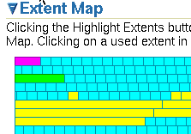

Allocating Extents
  Searching the data file’s bitmap for the required number of adjacent free blocks
  Sizing extents with storage clauses:
    UNIFORM
    AUTOALLOCATE
  Viewing extent map
  Obtaining deallocation
  advice
Notes:
Allocating Extents
With locally managed tablespaces, the Oracle database server looks for free space to allocate to a new extent by first determining a candidate data file in the tablespace and then searching the data file’s bitmap for the required number of adjacent free blocks. If that data file does not have enough adjacent free space, then the Oracle database server looks in another data file.
Two clauses affect the sizing of extents:
With the UNIFORM clause, the database creates all extents of a uniform size that you specified (or a default size) for any objects created in the tablespace.
With the AUTOALLOCATE clause, the database determines the extent-sizing policy for the tablespace.
To view the extent map in Enterprise Manager, choose Server > Tablespaces > View Tablespace > Show Tablespace Contents.
The Oracle database server provides a Segment Advisor that helps you determine whether an object has space available for reclamation on the basis of the level of space fragmentation within the object.

Slide 11





Allocating Space
New space allocation method:
  DEFERRED_SEGMENT_CREATION = TRUE (default)
  1. Table creation > Data dictionary operation
  2. DML > Segment creation
CREATE TABLE
INSERT INTO
    Saving disk space
    Improving installation time
        of big applications
Notes:
Allocating Space
Oracle Database 11gR2 includes a new space allocation method. When you create a nonpartitioned heap table, the table segment creation is deferred to the first row insert. This functionality is enabled by default with the DEFERRED_SEGMENT_CREATION initialization parameter set to TRUE.
Advantages of this new space allocation method:
A significant amount of disk space can be saved for applications that create hundreds or thousands of tables upon installation, many of which might never be populated.
The application installation time is reduced.
When you insert the first row into the table, the segments are created for the base table, its LOB columns, and its indexes. During segment creation, cursors on the table are invalidated. These operations have a small additional impact on performance.
Note: With this new allocation method, it is essential that you do proper capacity planning so that the database has enough disk space to handle segment creation when tables are populated. For more details, see the Oracle Database Administrator’s Guide.

Slide 12
Creating Tables Without Segments
SQL> SHOW PARAMETERS deferred_segment_creation
NAME TYPE VALUE
------------------------------------ ----------- ------
deferred_segment_creation boolean TRUE
SQL> CREATE TABLE seg_test(c number, d varchar2(500));
Table created.
SQL> SELECT segment_name FROM user_segments;
no rows selected
Inserting rows and creating segments:
SQL> INSERT INTO seg_test VALUES(1, 'aaaaaaa');
1 row created.
SQL> SELECT segment_name FROM user_segments;
SEGMENT_NAME
-------------------------------------------------------
SEG_TEST
Notes:
Creating Tables Without Segments
This slide shows you how to check the DEFERRED_SEGMENT_CREATION parameter. Then a table is created without segments, which you can verify by querying the USER_SEGMENTS data dictionary view. After the insert of a row, you query this view again to see that the segment now exists.
You can also query the SEGMENT_CREATED column of the USER_TABLES, USER_INDEXES, or USER_LOBS views. For nonpartitioned tables, indexes, and LOBs, this column shows YES if the segment is created.
Another addition to the data dictionary is the SYS.SEG$ table that stores the storage parameters that you specified during table or index creation.

Slide 13
Controlling Deferred Segment Creation
With the DEFERRED_SEGMENT_CREATION parameter in the:
  Initialization file
  ALTER SESSION command
  ALTER SYSTEM command
With the SEGMENT CREATION clause:
  IMMEDIATE
  DEFERRED (default in Oracle Database 11gR2)
  CREATE TABLE SEG_TAB3(C1 number, C2 number)
  SEGMENT CREATION IMMEDIATE TABLESPACE SEG_TBS;
  CREATE TABLE SEG_TAB4(C1 number, C2 number)
  SEGMENT CREATION DEFERRED;
Note: Indexes inherit table characteristics.
Notes:
Controlling Deferred Segment Creation
Segment creation can be controlled in two ways:
With the DEFERRED_SEGMENT_CREATION initialization parameter set to TRUE or FALSE. This parameter can be set in the initialization file. You can also control it via the ALTER SESSION or ALTER SYSTEM commands.
Examples:
ALTER SESSION SET DEFERRED_SEGMENT_CREATION = TRUE;
ALTER SYSTEM SET DEFERRED_SEGMENT_CREATION = FALSE;
With the SEGMENT CREATION clause of the CREATE TABLE command:
SEGMENT CREATION DEFERRED: If specified, segment creation is deferred until the first row is inserted into the table. This is the default behavior for Oracle Database 11gR2.
SEGMENT CREATION IMMEDIATE: If specified, segments are materialized during table creation. This is the default behavior in Oracle databases prior to Oracle Database 11gR2.
This clause takes precedence over the DEFERRED_SEGMENT_CREATION parameter.
It is possible to force the creation of segments for an already created table with the ALTER TABLE … MOVE command.
However, it is not possible to directly control the deferred segment creation for dependent objects such as indexes. They inherit this characteristic from their parent object—in this case, the table.

Slide 14
Restrictions and Exceptions
Segment creation on demand:
  Only for nonpartitioned tables and indexes
  Not for IOTs, clustered tables, or other special tables
  Not for tables in dictionary-managed tablespaces
  Note: If you were to migrate a table without segments from a locally managed to a dictionary-managed tablespace, you must drop and re-create it.
Notes:
Restrictions and Exceptions
In Oracle Database 11gR2, deferred segment creation is restricted to nonpartitioned tables and nonpartitioned indexes. IOTs and other special tables are not supported.
Segment creation on demand is not supported for tables created in dictionary-managed tablespaces and for clustered tables. An attempt to do so creates segments.
If you create a table with deferred segment creation on a locally managed tablespace, it has no segments. If at a later time, you migrate the tablespace to be dictionary-managed, any attempt to create segments produces errors. In this case, you must drop the table and re-create it.
Segment creation on demand is not supported for clustered tables, global temp tables, session-specific temp tables, internal tables, typed tables, AQ tables, SYS-owned tables, external tables, bitmap join indexes, and domain indexes. Tables owned by SYSTEM, PUBLIC, OUTLN, and XDB are also excluded.

Slide 15
Additional Automatic Functionality
Without user intervention:
  No segments for unusable indexes and index partitions
  Creating an index without a segment:
      CREATE INDEX test_i1 ON seg_test(c) UNUSABLE;
  Removing any allocated space for an index:
      ALTER INDEX test_i UNUSABLE;
  Creating the segment for an index:
      ALTER INDEX test_i REBUILD;
      SELECT segment_name, partition_name, segment_type
      FROM user_segments
      WHERE segment_name like '%DEMO';
Notes:
Additional Automatic Functionality
Additional enhancements in Oracle Database 11g Release 2 (unrelated to the deferred segment creation) are implemented to save space: all UNUSABLE indexes and index partitions are created without a segment. This functionality is completely transparent for you. It is enabled by default with the COMPATIBILITY initialization parameter set to 11.2.0.0.
Example: If you have a DEMO table with three partitions and a local index, you see three table and three index segments when executing the query, which is shown in the slide.
If you execute the same query after you move one table partition to a new tablespace, you see three table segments and only two index segments because the unusable one is automatically deleted.

Slide 16
Quiz
Which of the following statements are true for Oracle Database 11g Release2?
  Deferred segment creation is always enabled. You cannot control it.
  You can control the deferred segment creation with the SEGMENT CREATION clause of the CREATE TABLE command.
  Segment creation on demand is available for all types of tables, including those owned by the SYS user.
  Segment creation on demand is available for nonpartitioned tables.
Notes:
Answer: 2, 4

Slide 17
Table Compression: Overview
Reducing storage costs by compressing all data:
  Basic compression for direct-path insert operations: 10x
  OLTP compression for all DML operations: 2–4x
{ COMPRESS [ BASIC | FOR { OLTP} ] | NOCOMPRESS }
Compression Method | Compression Ratio | CPU Overhead | CREATE and ALTER TABLE Syntax | Typical Applications
Basic table compression | High | Minimal | COMPRESS [BASIC] | DSS
OLTP table compression | High | Minimal | COMPRESS FOR OLTP | OLTP, DSS
Notes:
Table Compression: Overview
Oracle Database supports three methods of table compression:
Basic table compression
OLTP table compression
Hybrid columnar compression (with Exadata)
Oracle Corporation recommends to compress all data to reduce storage costs. The Oracle database can use table compression to eliminate duplicate values in a data block. For tables with highly redundant data, compression saves disk space and reduces memory use in the database buffer cache. Table compression is transparent to database applications.
The table_compression clause is valid only for heap-organized tables. The COMPRESS keyword enables table compression. The NOCOMPRESS keyword disables table compression. NOCOMPRESS is the default.
With basic compression, the Oracle database compresses data at the time of performing bulk load using operations such as direct loads or CREATE TABLE AS SELECT.
With COMPRESS FOR OLTP, the Oracle database compresses data during all DML operations on the table.

Slide 18
Compression for Direct-Path Insert Operations
  Is enabled with CREATE TABLE … COMPRESS BASIC …;
  Is recommended for bulk loading data warehouses
  Replaces deprecated COMPRESS FOR DIRECT_LOAD OPERATIONS
  Maximizes contiguous free space in blocks
Header
PCTFREE
= 0
Free
space
Uncompressed
data
Compressed
data
Data block
Inserts are
uncompressed.
PCTFREE reached
triggers compression.
Inserts are again
uncompressed.
PCTFREE reached
triggers compression.
Notes:
Compression for Direct-Path Insert Operations
With COMPRESS or COMPRESS BASIC, you enable basic table compression.
The Oracle database attempts to compress data during the following direct-path insert operations when it is productive to do so:
Direct-path SQL*Loader
CREATE TABLE AS SELECT statements
Parallel INSERT statements
INSERT statements with an APPEND hint
The original import utility (imp) does not support direct-path INSERT, and therefore cannot import data in a compressed format.
In earlier releases, this type of compression was called DSS table compression and was enabled using COMPRESS FOR DIRECT_LOAD OPERATIONS. This syntax has been deprecated.
Compression eliminates holes created due to deletions and maximizes contiguous free space in blocks.
The slide shows you a data block evolution when that block is part of a compressed table. You should read it from left to right. At the start, the block is empty and available for inserts. When you start inserting into this block, data is stored in an uncompressed format (as for uncompressed tables). However, as soon as the block is filled based on the PCTFREE setting of the block, the data is automatically compressed, potentially reducing the space it originally occupied.

Slide 19
Notes Page: Compression for Direct-Path Insert Operations
Notes:
Compression for Direct-Path Insert Operations (continued)
This allows for new uncompressed inserts to take place in the same block, until it is once again filled based on the PCTFREE setting. At that point, compression is triggered again to reduce the amount of space used in the block.
Note: Tables with COMPRESS or COMPRESS BASIC use a PCTFREE value of 0 to maximize compression, unless you explicitly set a value for PCTFREE clause.
Tables with COMPRESS FOR OLTP or NOCOMPRESS use the PCTFREE default value of 10 to maximize compress while still allowing for some future DML changes to the data, unless you override this default explicitly.

Slide 20
OLTP Compression for DML Operations
  Is enabled with
  CREATE TABLE … COMPRESS FOR OLTP …;
  Is recommended for active OLTP environments
  Replaces deprecated COMPRESS FOR ALL OPERATIONS
G
Y
Y
Y
Y
Y
Y
Y
G
Y
G
G
Y
G
G
Y
Y
G
G
Y
Y
G
Uncompressed
block
OLTP compression with symbol table at the beginning of the block
Notes:
OLTP Compression for DML Operations
With COMPRESS FOR OLTP, you enable OLTP table compression.
The Oracle database compresses data during all DML operations on the table. This form of compression is recommended for active OLTP environments.
In earlier releases, OLTP table compression was enabled with COMPRESS FOR ALL OPERATIONS. This syntax has been deprecated.
With OLTP compression, duplicate values in the rows and columns in a data block are stored once at the beginning of the block in a symbol table. Duplicate values are replaced with a short reference to the symbol table (as shown in the slide). Thus, information needed to re-create the uncompressed data is stored in the block.
To illustrate the principle of OLTP compression, the diagram in the slide shows two rectangles. The first gray rectangle contains four small green squares labeled “G” and six yellow ones labeled “Y.” They represent uncompressed blocks. At the beginning of the second gray rectangle, there is only one green square labeled “G” and one yellow “Y” square, representing the symbol table. The second gray diagram shows 10 white squares in the same position as the green and yellow ones. They are white because they are now only a reference, not consuming space for duplicate values.

Slide 21
Specifying Table Compression
You can specify table compression for:
  An entire heap-organized table
  A partitioned table (Each partition can have a different type or level of compression.)
  The storage of a nested table
You cannot :
  Specify basic and OLTP compression on tables with more than 255 columns
  Drop a column if a table is compressed for direct-loads, but you can drop it if the table is OLTP compressed
Notes:
Specifying Table Compression
You can specify table compression:
For an entire heap-organized table (in the physical_properties clause of relational_table or object_table)
For partitioned tables (Each partition can have a different type or level of compression.)
For the storage of a nested table (in the nested_table_col_properties clause)
Table compression has the following restrictions:
COMPRESS FOR OLTP and COMPRESS BASIC are not supported for tables with more than 255 columns.
You cannot drop a column from a table that is compressed for direct-load operations, although you can set such a column as unused. All the operations of the ALTER TABLE ... drop_column_clause are valid for tables that are compressed for OLTP.
Logical standby, Streams, and LogMiner are not supported on hybrid columnar compressed tables.

Slide 22
Using the Compression Advisor
The compression advisor:
  Analyzes objects to give an estimate of space savings for different compression methods
  Helps in deciding the correct compression level for an application
  Recommends various strategies for compression
    Picks the right compression algorithm for a particular data set
    Sorts on a particular column for increasing the compression ratio
    Presents tradeoffs between different compression algorithms
  Works for OLTP compression (via EM)
Notes:
Using the Compression Advisor
The compression advisor analyzes database objects and determines the expected compression ratios that can be achieved for each compression level. So it helps you determine the proper compression levels for your application. The advisor recommends various strategies for compression. When you access it from EM, it determines OLTP compression.

Slide 23
Using the DBMS_COMPRESSION Package
To determine optimal compression ratios:
BEGIN
DBMS_COMPRESSION.GET_COMPRESSION_RATIO ('USERS','SH','SALES',
NULL,DBMS_COMPRESSION.COMP_FOR_OLTP, blkcnt_cmp, blkcnt_uncmp,
rowcnt_cmp, rowcnt_uncmp, comptype);
DBMS_OUTPUT.PUT_LINE('Blk count compressed = ' || blkcnt_cmp);
DBMS_OUTPUT.PUT_LINE('Blk count uncompressed = ' || blkcnt_uncmp);
DBMS_OUTPUT.PUT_LINE('Row count per block compressed = ' || rowcnt_cmp);
DBMS_OUTPUT.PUT_LINE('Row count per block uncompressed = ' || rowcnt_uncmp);
DBMS_OUTPUT.PUT_LINE('Compression type = ' || comptype);
DBMS_OUTPUT.PUT_LINE('Compression ratio = '||blkcnt_uncmp/blkcnt_cmp||' to 1');
Notes:
Using the DBMS_COMPRESSION Package
A compression advisor, provided by the DBMS_COMPRESSION package, helps you to determine the compression ratio that can be expected for a specified table. The advisor analyzes the objects in the database, discovers the possible compression ratios that could be achieved, and recommends optimal compression levels. In addition to the DBMS_COMPRESSION package, the compression advisor can also be used within the existing advisor framework (with the DBMS_ADVISOR package).
To determine the compression ratio, the DBMS_COMPRESSION package has the following subprograms:
The GET_COMPRESSION_RATIO procedure gives you the possible compression ratio for an uncompressed table.
The GET_COMPRESSION_TYPE procedure returns the compression type for a given row.
For more details, see the Oracle Database PL/SQL Packages and Types Reference.

Slide 24
Compressing Table Data
Compression Method | Compression Ratio | CPU Overhead | CREATE and ALTER TABLE Syntax | Typical Applications
Basic table compression | High | Minimal | COMPRESS [BASIC] | DSS
OLTP table compression | High | Minimal | COMPRESS FOR OLTP | OLTP, DSS
Notes:
Compressing Table Data
Oracle Database supports three methods of table compression:
Basic table compression
OLTP table compression
Hybrid columnar compression (with Exadata)

Slide 25
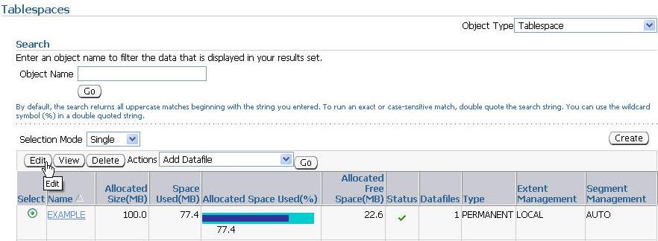
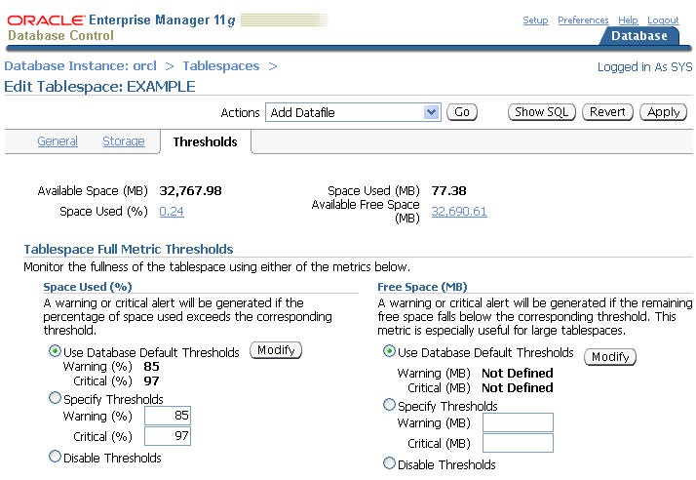
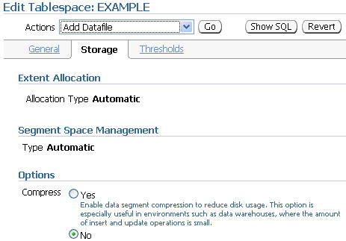
Proactive Tablespace Monitoring
Notes:
Proactive Tablespace Monitoring
Tablespace disk space usage is proactively managed by the database in the following ways:
Through the use of database alerts, you are informed when a tablespace runs low on available disk space as well as when particular segments are running out of space. You can then provide the tablespace with more disk space, thus avoiding out-of-space conditions.
Information gathered is stored in the Automatic Workload Repository (AWR) and is used to perform growth trend analysis and capacity planning of the database.
To view and modify tablespace information in Enterprise Manager, select Server from the Database Home page, and then select Tablespaces. Select the tablespace of your choice and click the Edit button.

Slide 26


Thresholds and Resolving Space Problems
97% full or 5 MB left critical
Alert
85% full or 100 MB left warning
DBA
Resolve space problem
Locally managed tablespace
Resolve space problem by:
  Adding or resizing data file
  Setting AUTOEXTEND ON
  Shrinking objects
  Reducing UNDO_RETENTION
  Checking for long-running queries in temporary tablespaces
Notes:
Oracle Database 11g: Administration Workshop II 18 - <number>
Thresholds and Resolving Space Problems
Tablespace thresholds are defined either as full or as available space in the tablespace. Critical and warning thresholds are the two thresholds that apply to a tablespace. The DBMS_SERVER_ALERT package contains procedures to set and get the threshold values. When the tablespace limits are reached, an appropriate alert is raised. The threshold is expressed in terms of a percentage of the tablespace size or in remaining bytes free. It is calculated in memory. You can have both a percentage and a byte-based threshold defined for a tablespace. Either or both of them may generate an alert.
The ideal setting for the warning threshold trigger value results in an alert that is early enough to ensure that there is enough time to resolve the problem before it becomes critical, but late enough so that you are not bothered when space is not a problem.
The alert indicates that the problem can be resolved by doing one or more of the following:
Adding more space to the tablespace by adding a file or resizing existing files, or making an existing file autoextendable
Freeing up space on disks that contain any autoextendable files
Shrinking sparse objects in the tablespace

Slide 27
Monitoring Tablespace Space Usage
Check every 10 min.
97% Critical
Cleared
Alert
85% Warning
Cleared
Alert
MMON
  Read-only and offline tablespaces: Do not set up alerts.
  Temporary tablespace: Threshold corresponds to space currently used by sessions.
  Undo tablespace: Threshold corresponds to space used by active and unexpired extents.
  Autoextensible files: Threshold is based on the maximum file size.
Notes:
Oracle Database 11g: Administration Workshop II 18 - <number>
Monitoring Tablespace Space Usage
The database tracks space utilization while performing regular space management activities. This information is aggregated every 10 minutes by the MMON process. An alert is triggered when the threshold for a tablespace has been reached or cleared.
Alerts should not be flagged on tablespaces that are in read-only mode, or tablespaces that were taken offline, because there is not much to do for them.
In temporary tablespaces, the threshold value has to be defined as a limit on the used space in the tablespace.
For undo tablespaces, an extent is reusable if it does not contain active or unexpired undo. For the computation of threshold violation, the sum of active and unexpired extents is considered as used space.
For tablespaces with autoextensible files, the thresholds are computed according to the maximum file size you specified, or the maximum OS file size.

Slide 28
Shrinking Segments
HWM
ALTER TABLE employees SHRINK SPACE COMPACT;
1
HWM
  DML operations and queries can be issued during compaction.
ALTER TABLE employees SHRINK SPACE;
2
HWM
  DML operations are blocked when the HWM is adjusted.
Notes:
Shrinking Segments
The diagram in the slide describes the two phases of a table shrink operation. The first phase does the compaction. During this phase, rows are moved to the left part of the segment as much as possible. Internally, rows are moved by packets to avoid locking issues. After the rows have been moved, the second phase of the shrink operation is started. During this phase, the high-water mark (HWM) is adjusted and the unused space is released.
The COMPACT clause is useful if you have long-running queries that might span the shrink operation and attempt to read from blocks that have been reclaimed. When you specify the SHRINK SPACE COMPACT clause, the progress of the shrink operation is saved in the bitmap blocks of the corresponding segment. This means that the next time a shrink operation is executed on the same segment, the Oracle database server remembers what has been done already. You can then reissue the SHRINK SPACE clause without the COMPACT clause during off-peak hours to complete the second phase.

Slide 29

Results of Shrink Operation
  Improved performance and space utilization
  Indexes maintained
  Triggers not executed
  Number of migrated rows may be reduced.
  Rebuilding secondary indexes on IOTs recommended
Index
Table
Shrink
DBA
Triggers not executed
Notes:
Results of Shrink Operation
Shrinking a sparsely populated segment improves the performance of scan and DML operations on that segment. This is because there are fewer blocks to look at after the segment has been shrunk. This is especially true for:
Full table scans (fewer and denser blocks)
Better index access (fewer I/Os on range ROWID scans due to a more compact tree)
Also, by shrinking sparsely populated segments, you enhance the efficiency of space utilization inside your database because more free space is made available for objects in need.
Index dependency is taken care of during the segment shrink operation. The indexes are in a usable state after shrinking the corresponding table. Therefore, no further maintenance is needed.
The actual shrink operation is handled internally as an INSERT/DELETE operation. However, any DML triggers are not executed because the data itself is not changed.
As a result of a segment shrink operation, it is possible that the number of migrated rows is reduced. However, you should not always depend on reducing the number of migrated rows after a segment has been shrunk. This is because a segment shrink operation may not touch all the blocks in the segment. Therefore, it is not guaranteed that all the migrated rows are handled.
Note: It is recommended to rebuild secondary indexes on an index-organized table (IOT) after a shrink operation.

Slide 30
Reclaiming Space Within ASSM Segments
  Online and in-place operation
  Applicable only to segments residing in ASSM tablespaces
  Candidate segment types:
    Heap-organized tables and index-organized tables
    Indexes
    Partitions and subpartitions
    Materialized views and materialized view logs
Notes:
Space Reclamation with ASSM
A shrink operation is an online and in-place operation because it does not need extra database space to be executed.
You cannot execute a shrink operation on segments managed by free lists. Segments in automatic segment space–managed tablespaces can be shrunk. However, the following objects stored in ASSM tablespaces cannot be shrunk:
Tables in clusters
Tables with LONG columns
Tables with on-commit materialized views
Tables with ROWID-based materialized views
IOT mapping tables
Tables with function-based indexes
ROW MOVEMENT must be enabled for heap-organized segments.

Slide 31
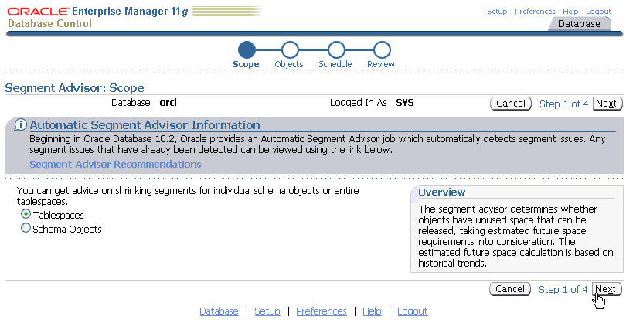
Segment Advisor: Overview
Notes:
Oracle Database 11g: Administration Workshop II 18 - <number>
Segment Advisor: Overview
The Segment Advisor identifies segments that have space available for reclamation. It performs its analysis by examining usage and growth statistics in the Automatic Workload Repository (AWR), and by sampling the data in the segment. It is configured to run automatically at regular intervals, and you can also run it on demand (manually). The regularly scheduled Segment Advisor run is known as the Automatic Segment Advisor.
After the recommendations are made, you can choose to implement the recommendations. The shrink advisor can be invoked at the segment or tablespace level.
The EM Database Control Console is the interface to the Segment Advisor. You can access the Segment Advisor from several places within EM:
Advisor Central page
Tablespaces page
Schema object pages
The Database Control Console provides the option to select various inputs and schedule a job that calls the Segment Advisor to get shrink advice. The Segment Advisor Wizard can be invoked with no context, in the context of a tablespace, or in the context of a schema object.
The Segment Advisor makes recommendation on the basis of sampled analysis, historical information, and future growth trends.

Slide 32
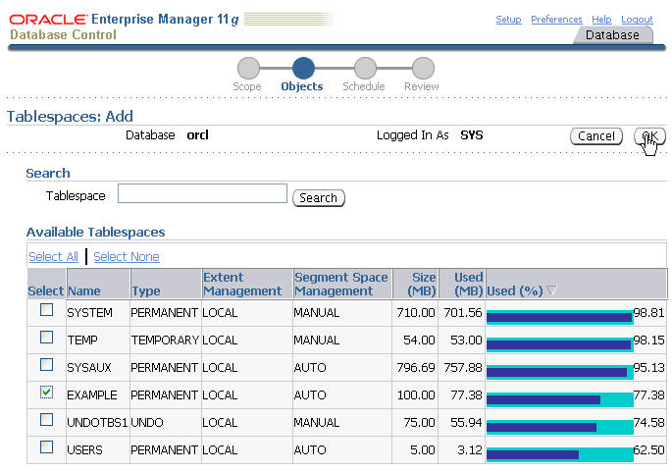
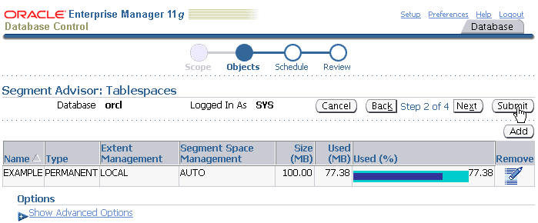
Segment Advisor
Notes:
Oracle Database 11g: Administration Workshop II 18 - <number>
Segment Advisor
From the Server page, select Tablespaces in the Storage section. On the Tablespaces page, select the tablespace on which you want to perform the shrink analysis, and then select Run Segment Advisor in the Actions drop-down list. Click Go to open the Segment Advisor initial page. You must choose “comprehensive” or “limited” analysis mode. In comprehensive mode, the analysis is longer because the advisor is sampling the segments to identify the right targets.
Keep clicking Continue to answer the various questions of the advisor. You end up on the Segment Advisor: Review page, where you can review the details of your analysis. The Segment Advisor analysis is run as a scheduled job, so you can review the scheduled task from the Advisor Central page. When completed, you can review the advisor’s recommendations.
Note: In the Segment Advisor, you can specify the duration of the analysis. This enables you to limit the time the advisor takes to produce recommendations. Generally speaking, a longer analysis period produces more comprehensive results. The results are stored in the AWR and can be viewed later. Use the “Number of days to retain” option to instruct the Oracle database server how long these results should be preserved before being purged from the AWR.

Slide 33
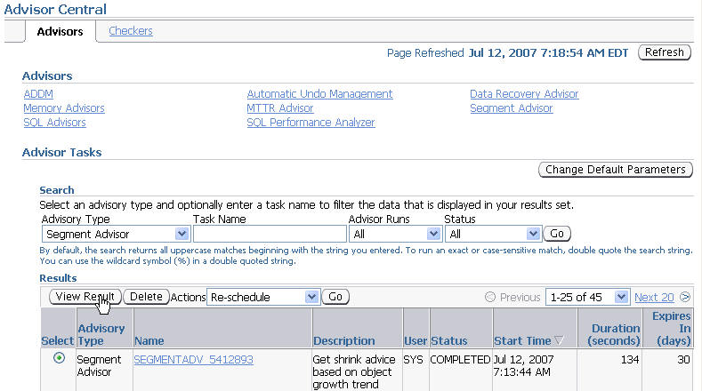
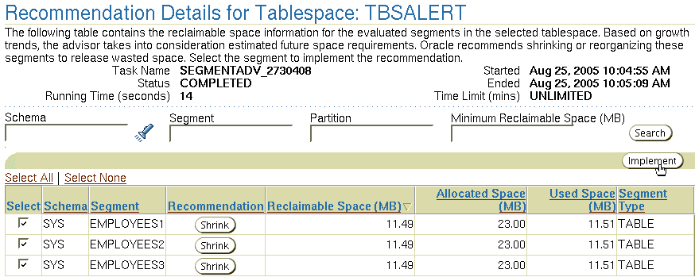

Implementing Recommendations
Notes:
Oracle Database 11g: Administration Workshop II 18 - <number>
Implementing Recommendations
After the Segment Advisor completes its job, you can view the recommendation details and implement them directly.
Note: Before shrinking a heap-organized table, you must enable row movement on that table. You can do this with Database Control from the Options tab on the Edit Table page.

Slide 34
Automatic Segment Advisor
The Automatic Segment Advisor:
  Is started by a Scheduler job set to run during the default maintenance window:
    Weeknights, Monday–Friday, from 10:00 PM to 2:00 AM
    Saturday and Sunday, both windows start at 6:00 AM and last for 20 hours
  Examines database statistics, samples segment data, and then selects the following objects to analyze:
    Tablespaces that have exceeded a critical or warning threshold
    Segments that have the most activity
    Segments that have the highest growth rate
Notes:
Automatic Segment Advisor
The Automatic Segment Advisor is started by a Scheduler job that is configured to run during the default maintenance window. The default maintenance window is specified in the Scheduler, and is initially defined as follows:
Weeknights, Monday through Friday, from 10:00 PM to 2:00 AM (4 hours each night)
Weekends, Saturday and Sunday morning at 6:00 AM and lasting for 20 hours each day.
The Automatic Segment Advisor does not analyze every database object. Instead, it examines database statistics, samples segment data, and then selects the following objects to analyze:
Tablespaces that have exceeded a critical or warning space threshold
Segments that have the most activity
Segments that have the highest growth rate
If an object is selected for analysis but the maintenance window expires before the Segment Advisor can process the object, the object is included in the next Automatic Segment Advisor run. You cannot change the set of tablespaces and segments that the Automatic Segment Advisor selects for analysis. You can, however, enable or disable the Automatic Segment Advisor job, change the times during which the Automatic Segment Advisor is scheduled to run, or adjust Automatic Segment Advisor system resource utilization.

Slide 35
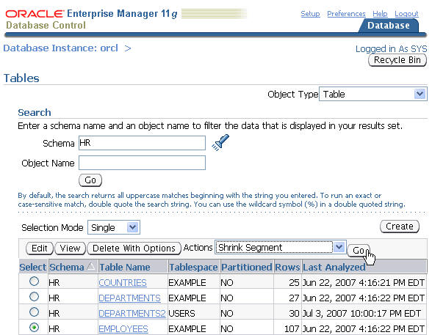
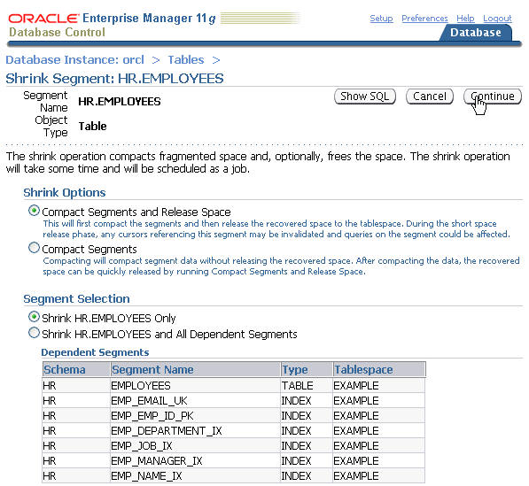
Manual Segment Shrink Using EM
Notes:
Oracle Database 11g: Administration Workshop II 18 - <number>
Manual Segment Shrink Using EM
Alternatively (to implementing the Segment Advisor recommendations), you can shrink individual segments associated with specific database objects. For example, from the Database Home page, select the Schema folder tab then click the Tables link in the Database Objects section. On the Tables page, select your table, and then select Shrink Segment in the Actions drop-down list. Then click the Go button. This brings you to the Shrink Segment page, where you can choose the dependent segments to shrink. You have the opportunity to compact only or to compact and release the space. You can also choose the CASCADE option.
When done, click the Continue link. This submits the shrink statements as a scheduled job.

Slide 36
Shrinking Segments Using SQL
ALTER … SHRINK SPACE [CASCADE][COMPACT]
TABLE [OVERFLOW]
INDEX
MATERIALIZED VIEW
MATERIALIZED VIEW LOG
MODIFY PARTITION
MODIFY SUBPARTITION
MODIFY LOB
1
ALTER TABLE employees ENABLE ROW MOVEMENT;
2
ALTER TABLE employees SHRINK SPACE CASCADE;
3
ALTER TABLE employees MODIFY LOB(resume) (SHRINK SPACE);
4
ALTER TABLE employees OVERFLOW SHRINK SPACE;
Notes:
Shrinking Segments Using SQL
Because a shrink operation may cause ROWIDs to change in heap-organized segments, you must enable row movement on the corresponding segment before executing a shrink operation on that segment. Row movement by default is disabled at segment level. To enable row movement, the ENABLE ROW MOVEMENT clause of the CREATE TABLE or ALTER TABLE command is used. This is illustrated in the first example in the slide.
Use the ALTER command to invoke segment shrink on an object. The object’s type can be one of the following: table (heap- or index-organized), partition, subpartition, LOB (data and index segment), index, materialized view, or materialized view log.
Use the SHRINK SPACE clause to shrink space in a segment. If CASCADE is specified, the shrink behavior is cascaded to all the dependent segments that support a shrink operation, except materialized views, LOB indexes, and IOT (index-organized tables) mapping tables. The SHRINK SPACE clause is illustrated in the second example.
In an index segment, the shrink operation coalesces the index before compacting the data.
Example 3 shows a command that shrinks a LOB segment, given that the RESUME column is a CLOB.
Example 4 shows a command that shrinks an IOT overflow segment belonging to the EMPLOYEES table.
Note: For more information, refer to the Oracle Database SQL Reference guide.

Slide 37
Managing Resumable Space Allocation
A resumable statement:
  Enables you to suspend large operations instead of receiving an error
  Gives you a chance to fix the problem while the operation is suspended, rather than starting over
  Is suspended for the following conditions:
    Out of space
    Maximum extents reached
    Space quota exceeded
  A resumable statement can be suspended and resumed multiple times.
Notes:
Managing Resumable Space Allocation
The Oracle database server provides a means for suspending, and later resuming, the execution of large database operations in the event of space allocation failures. This enables you to take corrective action instead of the Oracle database server returning an error to the user. After the error condition is corrected, the suspended operation automatically resumes. This feature is called “resumable space allocation.” The statements that are affected are called “resumable statements.” A statement executes in resumable mode only when the resumable statement feature has been enabled for the system or session.
Suspending a statement automatically results in suspending the transaction. Thus all transactional resources are held through the suspension and resuming of a SQL statement. When the error condition disappears (for example, as a result of user intervention or perhaps sort space released by other queries), the suspended statement automatically resumes execution. A resumable statement is suspended when one of the following conditions occur:
Out of space condition
Maximum extents reached condition
Space quota exceeded condition
A suspension time-out interval is associated with resumable statements. A resumable statement that is suspended for the time-out interval (the default is 2 hours) reactivates itself and returns the exception to the user. A resumable statement can be suspended and resumed multiple times.
Note: A maximum extents reached error only happens with dictionary-managed tablespaces.

Slide 38
Using Resumable Space Allocation
  Queries, DML operations, and certain DDL operations can be resumed if they encounter an out-of-space error.
  A resumable statement can be issued through SQL, PL/SQL, SQL*Loader and Data Pump utilities, or the Oracle Call Interface (OCI).
  A statement executes in a resumable mode only if its session has been enabled by one of the following actions:
    The RESUMABLE_TIMEOUT initialization parameter is set to a nonzero value.
    An ALTER SESSION ENABLE RESUMABLE statement is issued:
ALTER SESSION ENABLE RESUMABLE;
INSERT INTO sales_new SELECT * FROM sh.sales;
ALTER SESSION DISABLE RESUMABLE;
Notes:
Using Resumable Space Allocation
Resumable space allocation is possible only when statements are executed within a session that has resumable mode enabled. There are two means of enabling and disabling resumable space allocation:
Issue the ALTER SESSION ENABLE RESUMABLE command.
Set the RESUMABLE_TIMEOUT initialization parameter to a nonzero value with an ALTER SESSION or ALTER SYSTEM statement.
When enabling resumable mode for a session or the database, you can specify a time-out period, after which a suspended statement errors out if no intervention has taken place. The RESUMABLE_TIMEOUT initialization parameter indicates the number of seconds before a time-out occurs. You can also specify the time-out period with the following command:
ALTER SESSION ENABLE RESUMABLE TIMEOUT 3600;
The value of TIMEOUT remains in effect until it is changed by another ALTER SESSION ENABLE RESUMABLE statement, it is changed by another means, or the session ends. The default time-out interval when using the ENABLE RESUMABLE TIMEOUT clause to enable resumable mode is 7,200 seconds, or 2 hours.

Slide 39
Notes:
Using Resumable Space Allocation (continued)
You can also give a name to resumable statements. For example:
ALTER SESSION ENABLE RESUMABLE TIMEOUT 3600
NAME 'multitab insert';
The name of the statement is used to identify the resumable statement in the DBA_RESUMABLE and USER_RESUMABLE views.
For example:
SELECT name, sql_text FROM user_resumable;
NAME SQL_TEXT
--------------- --------------------------------------------
multitab insert INSERT INTO oldsales SELECT * FROM sh.sales;
To automatically configure resumable statement settings for individual sessions, you can create and register a database-level LOGON trigger that alters a user’s session. The trigger issues commands to enable resumable statements for the session, specifies a time-out period, and associates a name with the resumable statements issued by the session.
Because suspended statements can hold up some system resources, users must be granted the RESUMABLE system privilege before they are allowed to enable resumable space allocation and execute resumable statements.

Slide 40

Resuming Suspended Statements
1
SQL statement
Full table
2
Suspended
Continue
SQL
operation
3
4
Optionally
5
Table with free space
AFTER
SUSPEND
trigger
Abort
Notes:
Resuming Suspending Statements
Example
1. An INSERT statement encounters an error saying the table is full.
2. The INSERT statement is suspended, and no error is passed to client.
3. Optionally, an AFTER SUSPEND trigger is executed.
4. Optionally, the SQLERROR exception is activated to abort the statement.
5. If the statement is not aborted and free space is successfully added to the table, the INSERT statement resumes execution.
Detecting a Suspended Statement
When a resumable statement is suspended, the error is not raised to the client. In order for corrective action to be taken, the Oracle database server provides alternative methods for notifying users of the error and for providing information about the circumstances.

Slide 41
Notes:
Resuming Suspended Statements (continued)
Possible Actions During Suspension
When a resumable statement encounters a correctable error, the system internally generates the AFTER SUSPEND system event. Users can register triggers for this event at both the database and schema level. If a user registers a trigger to handle this system event, the trigger is executed after a SQL statement has been suspended. SQL statements executed within an AFTER SUSPEND trigger are always nonresumable and are always autonomous. Transactions started within the trigger use the SYSTEM rollback segment. These conditions are imposed to overcome deadlocks and reduce the chance of the trigger experiencing the same error condition as the statement.
Within the trigger code, you can use the USER_RESUMABLE or DBA_RESUMABLE views, or the DBMS_RESUMABLE.SPACE_ERROR_INFO function to get information about the resumable statements.
When a resumable statement is suspended:
The session invoking the statement is put into a wait state. A row is inserted into V$SESSION_WAIT for the session with the EVENT column containing “statement suspended, wait error to be cleared”.
An operation-suspended alert is issued on the object that needs addition resources for the suspended statement to complete.
Ending a Suspended Statement
When the error condition is resolved (for example, as a result of DBA intervention or perhaps sort space released by other queries), the suspended statement automatically resumes execution and the “resumable session suspended” alert is cleared.
A suspended statement can be forced to activate the SERVERERROR exception by using the DBMS_RESUMABLE.ABORT() procedure. This procedure can be called by a DBA, or by the user who issued the statement. If the suspension time-out interval associated with the resumable statement is reached, the statement aborts automatically and an error is returned to the user.

Slide 42
What Operations Are Resumable?
The following operations are resumable:
  Queries: SELECT statements that run out of temporary space (for sort areas)
  DML: INSERT, UPDATE, and DELETE statements
  The following DDL statements:
      CREATE TABLE ... AS SELECT
      CREATE INDEX
      ALTER INDEX ... REBUILD
      ALTER TABLE ... MOVE PARTITION
      ALTER TABLE ... SPLIT PARTITION
      ALTER INDEX ... REBUILD PARTITION
      ALTER INDEX ... SPLIT PARTITION
      CREATE MATERIALIZED VIEW
Notes:
What Operations Are Resumable?
The following operations are resumable:
Queries: SELECT statements that run out of temporary space (for sort areas) are candidates for resumable execution. When using OCI, the OCIStmtExecute() and OCIStmtFetch() calls are candidates.
DML: INSERT, UPDATE, and DELETE statements are candidates. The interface used to execute them does not matter; it can be OCI, SQLJ, PL/SQL, or another interface. Also, INSERT INTO...SELECT from external tables can be resumable.
DDL: The following statements are candidates for resumable execution:
CREATE TABLE ... AS SELECT
CREATE INDEX
ALTER INDEX ... REBUILD
ALTER TABLE ... MOVE PARTITION
ALTER TABLE ... SPLIT PARTITION
ALTER INDEX ... REBUILD PARTITION
ALTER INDEX ... SPLIT PARTITION
CREATE MATERIALIZED VIEW

Slide 43
Quiz
Select the true statements about space management:
  Segment creation in Oracle Database 11g Release2 is deferred for all tables. There are no exceptions.
  All UNUSABLE indexes and index partitions are created without a segment.
  Shrinking segment space is a nonresumable operation.
  You can set thresholds by tablespace.
Notes:
Answer: 2, 4

Slide 44
Summary
In this lesson, you should have learned how to:
  Describe how the Oracle database server automatically manages space
  Save space by using compression
  Proactively monitor and manage tablespace space usage
  Describe segment creation in the Oracle database
  Control deferred segment creation
  Use the Segment Advisor
  Reclaim wasted space from tables and indexes by using the segment shrink functionality
  Manage resumable space allocation
Notes:
Oracle Database 11g: Administration Workshop II 18 - <number>

Slide 45
Practice 18 Overview:
Managing Storage
This practice covers the following topics:
  Using threshold alerts to proactively manage tablespaces
  Using the Segment Advisor to shrink space
  Viewing alerts and alert history in SQL*Plus and Enterprise Manager
Notes:
Oracle Database 11g: Administration Workshop II 18 - <number>

